Slide 1
INTERREG EUROPE
About INTERREG EUROPE
INTERREG IVC Joint Technical Secretariat
Iruma Kravale, The Ministry of Environmental Protection and Regional Development

Slide 2
Timeline
Programming – Indicative timeline
EU2020 strategy
March 2010
October 2011
Draft regulation
June 2012
INTERREG EUROPE Programming Committee set up
Adoption of legislative package & agreement on budget 2014-2020
Summer 2014
submission of the programme to the EC
1st half 2015
approval of the programme by the EC
2-3 December 2014
INTERREG EUROPE launch event, Bologna
April 2015
First call for project proposals expected

Slide 3
Rationale
Policy learning among public authorities to improve performance of policies & programmes for regional development, in particular Structural Funds programmes
EU Cohesion policy
Goal 1: Investment for growth & jobs (G&J)
EUR 340 billion
Goal 2: European Territorial Cooperation (ETC)
EUR 10.2 billion
INTERREG EUROPE
EUR 359 m
€
Notes:
It is important to highlight the rationale of the programme on this slide – in particular cohesion policy focus.
The funds allocated to ETC in total are 1/34 of the funds allocated to Goal 1
The funds allocated to INTERREG EUROPE are 1/1000 of the total Structural funds total
But this small pot of money is supposed to have an impact on improving how the total funds are spent (illustrated on next slide)

Slide 4
Rationale
Policy learning among public authorities to improve performance of policies & programmes for regional development, in particular Structural Funds programmes
EU Cohesion policy
Goal 1: Investment for growth & jobs (G&J)
EUR 340 billion
Goal 2: European Territorial Cooperation (ETC)
EUR 10.2 billion
INTERREG EUROPE
EUR 359 m
€
Notes:
The small yellow dot representing Interreg Europe spreads to all the other squares representing structural funds.
INTERREG EUROPE should improve policies and programmes so the money should be more focused in order to have an impact.

Slide 5
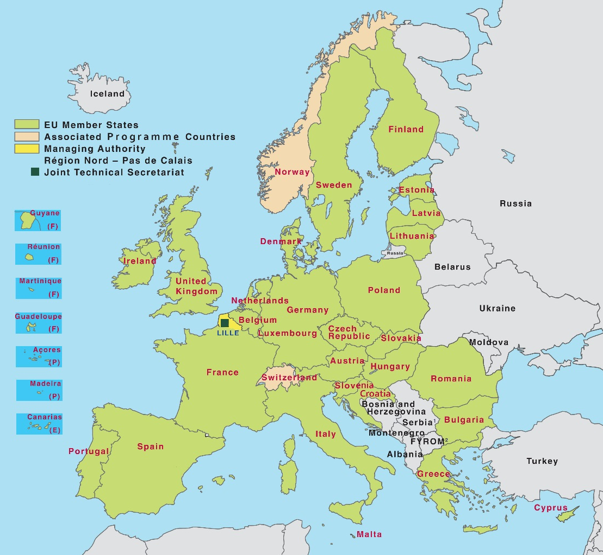
Cooperation area
30 countries
EU 28
Norway
Switzerland

Slide 6
Eligibility & co-financing rate
Who is eligible? | Co-financing rates
Public bodies and bodies governed by public law | 85%
Private non-profit bodies | 75%

Slide 7
Thematic focus
Four themes
Research & innovation
SME competitiveness
Low-carbon economy
Environment & resource efficiency

Slide 8
Proposed actions
2 actions
Interregional Cooperation Projects
Policy Learning
Platforms

Slide 9
Proposed actions
A. Interregional Cooperation Projects
Implementation in 2 phases
Policy exchange of experience (1 to 3 years)
ending with production of 1 action plan per region
Monitoring of action plan implementation (2 years)
+ possible pilot actions
Phase 1
Phase 2
Creation of ‘local stakeholder groups’
+ involve all organisations linked to policy process + reduce administrative/legal obstacles

Slide 10
Proposed actions
A. Interregional Cooperation Projects
Who should get involved?
Managing Authorities
find tried and tested measures to implement in your programme
share and implement good practices coming from across Europe
get involved with your policymaker and contribute to better policy implementation
Regional/local authorities
Agencies, institutes, non-profit private bodies

Slide 11
2. INTERREG EUROPE
A. Interregional Cooperation Projects
Application and reporting
Focus on SF programmes
A half of policy instruments addressed
Direct commitment of policymakers
Support letters from MAs/ IBs
Stakeholder groups
Broader policy learning and impact
Online (OLF) system
Application, report, request for changes

Slide 12
2. INTERREG EUROPE
A. Interregional Cooperation Projects
Financial simplifications (tbc)
Administration costs
15% of staff costs
Project preparation costs
Lump sum EUR 15.000,-
Budget changes
20% flexibility rules within approved budget

Slide 13
Proposed actions
B. Policy Learning Platforms
EU-wide capacity building on:
Research & innovation
SME competitiveness
Low-carbon economy
Environment & resource efficiency
1 service provider per theme via:
Online collaborative tool +
Expert team

Slide 14
Proposed actions
B. Policy Learning Platforms
Services
Exploit project results
Analyse, benchmark and disseminate the projects’ content
Improve programme content
Advise the programme on strategic orientation (e.g. calls for project proposals)
Build EU-wide capacity
Organise thematic events, peer reviews among regions
Produce thematic publications
Assist individual stakeholders involved in G&J and ETC
‘Animate’ the online tool for knowledge sharing
Advise running projects

Slide 15
Proposed actions
B. Policy Learning Platforms
Users
Bodies involved in management and implementation
of Growth & Jobs and European Territorial Cooperation programmes
Bodies involved in policy implementation
relevant to the four programme themes
Beneficiaries of G&J and ETC programmes
Two access levels
Public information for all users
Restricted area for registered users for extra services

Slide 16
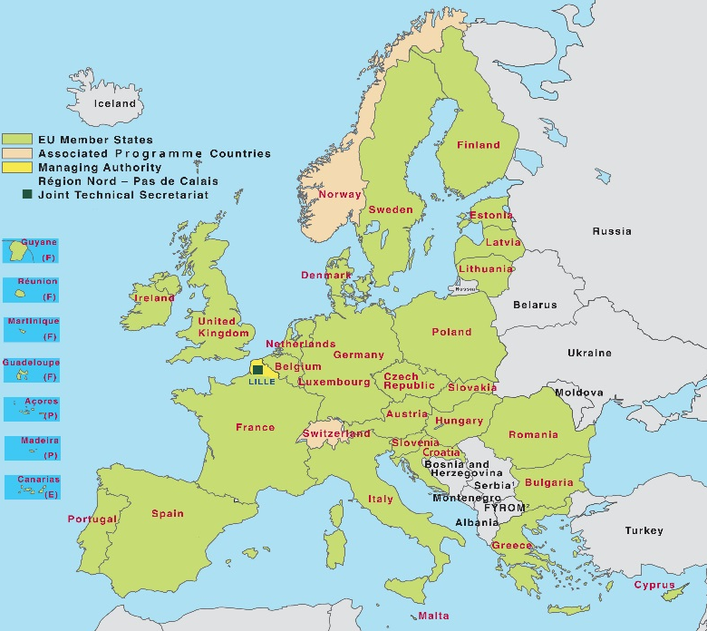
Proposed actions
2 interrelated actions
Policy Learning Platforms
Open to all regions
Enrich
Contribute
Interregional cooperation projects
Project 1
Project 2
Project 3

Slide 17
For more information, please, follow us on:
interreg4c.eu/interreg-europe
facebook.com/interreg4c
twitter.com/interreg4c
changing-regions.eu

